Slide 1
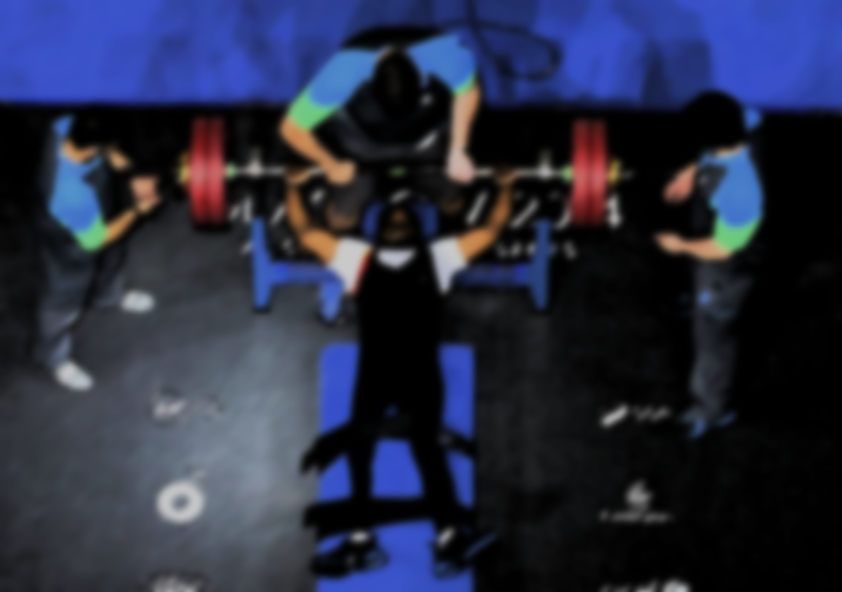
Epidemiology of Sport Injuries and Injury Prevention Strategies in Para Powerlifting
Alireza Nasirzadeh
(Ph.D. of sports biomechanics)

Slide 2
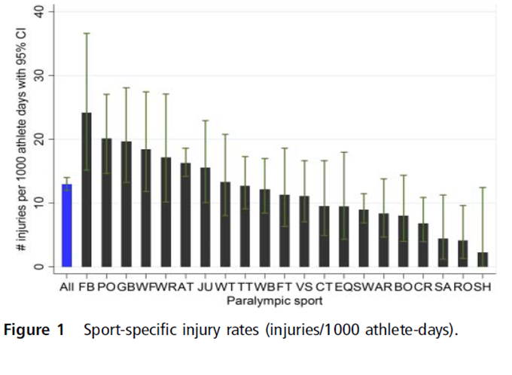
Injury Rate – London 2012

Slide 3
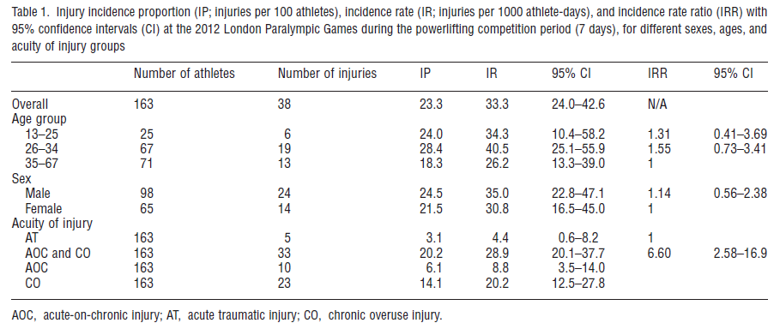
Injury Rate – London 2012

Slide 4
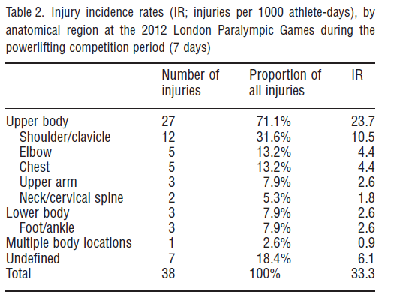
Injury Rate – London 2012

Slide 5
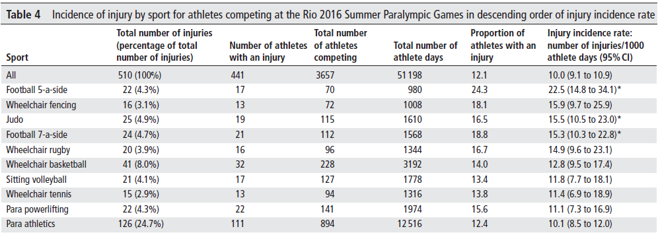
Injury Rate – Rio 2016

Slide 6
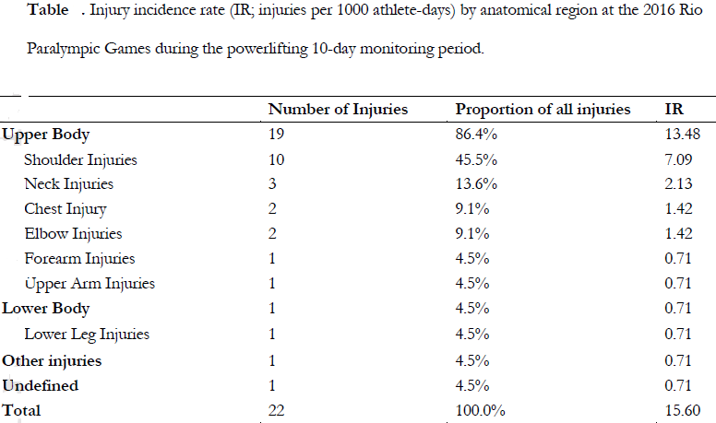
Injury Rate – Rio 2016

Slide 7
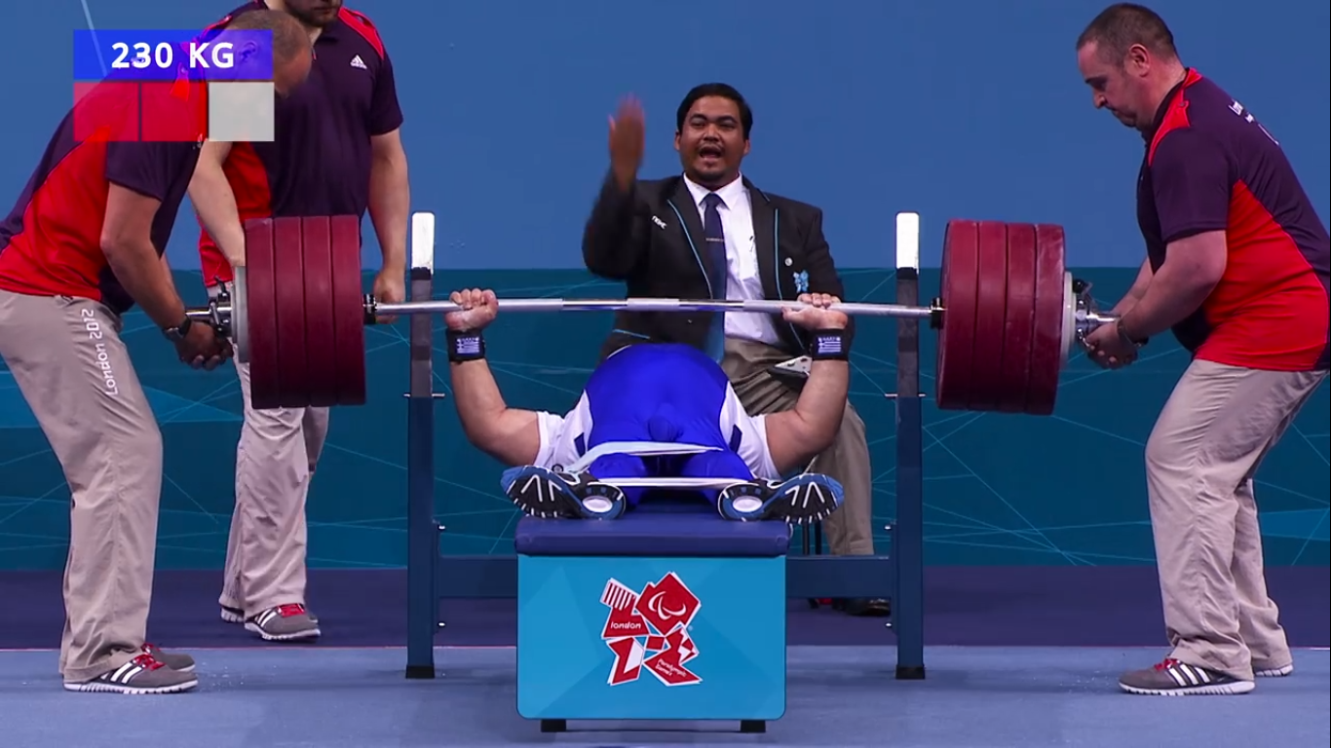
How we should look at it?
Horizontal plane
Notes:
The bench press is an upper-body weight training exercise in which the trainee presses a weight upwards while lying on a weight training bench. The exercise uses the pectoralis major, the anterior deltoids, and the triceps, among other stabilizing muscles.
And it consists of two phase: the decent phase and the lifting phase
transversely flex the shoulders

Slide 8
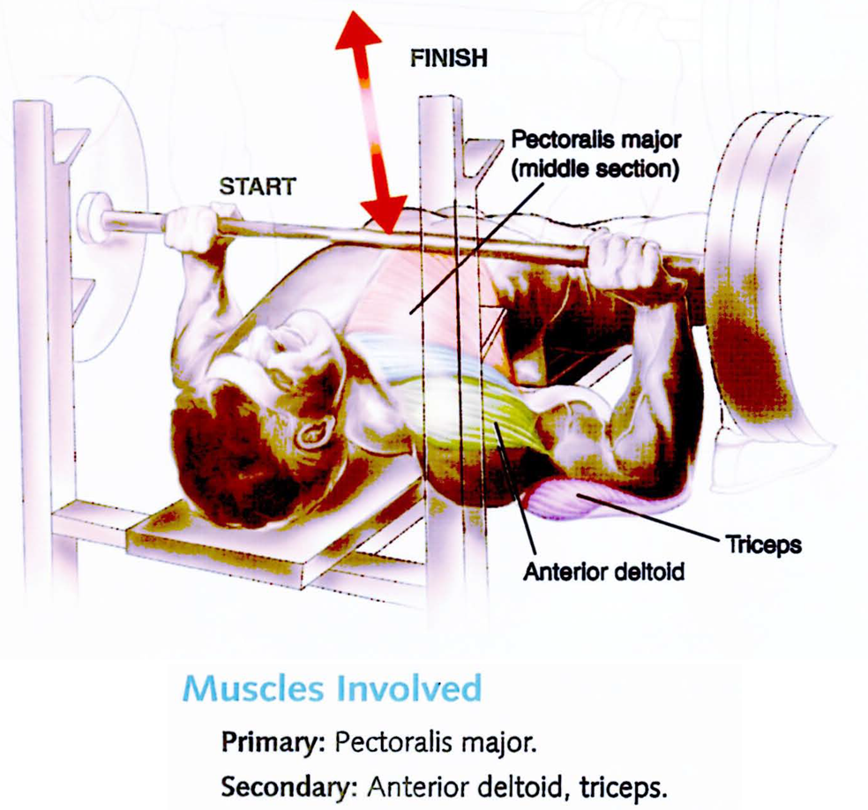
Muscular activity of Bench Press
Pectoralis Major:
lower portion of the decent phase and the early portion of the lifting phase,
Anterior Deltoid:
the mid position in both the descent and lifting phases,
Triceps Brachii:
late in the descent phase and early in the lift phase
Notes:
The Pectoralis Major is the primary muscle used in the Bench Press. Both the Sternal and Clavicular heads of the Pectoralis Major transversely flex the shoulders during the bench press (Lauver 2015, Duffey 2008). Pectoralis are utilized the greatest in the lower portion of the decent phase and the early portion of the lifting phase. Peak activity in the lift phase occurs early (35% lift time). (Duffey 2008).
The Anterior Deltoid assist in transverse flexion of the shoulders as well as flexion of the shoulders, particularly when the upper arms are closer the sides of the body. The Anterior Deltoids are utilized the greatest in the mid position in both the descent and lifting phases (Duffey 2008).
Triceps, particularly the lateral and medial heads extend the elbow during the Bench Press. They are utilized the greatest in the lifting phase as compared to the lowering phase. Like the Pectoralis Major, maximal activity of the triceps actually occur late in the descent phase and early in the lift phase. Their involvement also peaks again near the top of the lifting phase, particularly with a narrower grip. (Duffey 2008).
Biceps Brachii act as a dynamic stabilizer with low relative activity. Clemens (1997) measured Biceps Brachii involvement at approximately 22% maximum voluntary isometric contraction.
The Latissimus Dorsi remains relatively inactive during the bench press, at least in experienced non-competitive lifters (Barnett 1995).

Slide 9
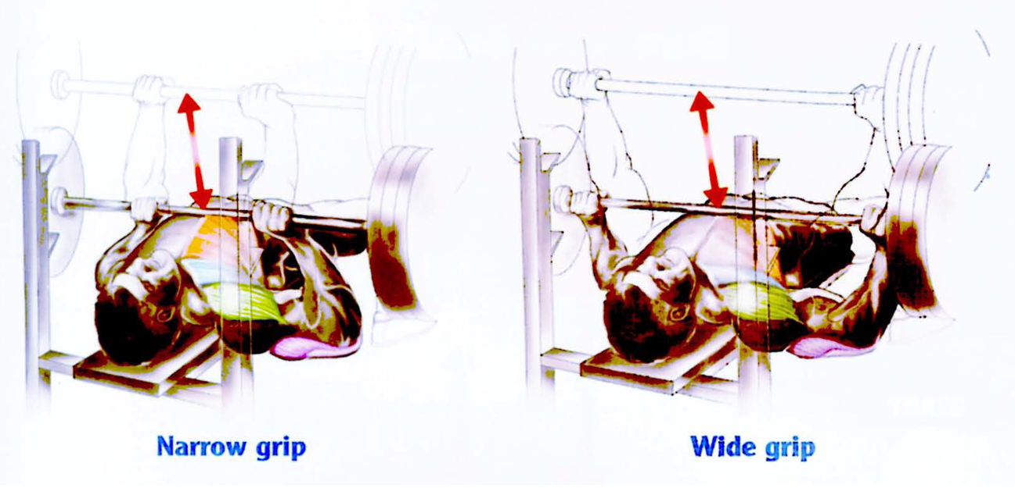
Grip Width
Bench press lifting performance increases as grip width is increased up to approximately twice the shoulder width.
Notes:
Grip the bar with an opposing thumb grip so that the barbell does not slide out of the hand onto the body. Position the wrists directly under the bar by turning the wrists out slightly so bar is placed on lower outer portion of palm. This grip positioning prevents the wrists from becoming completely hyperextended under the weight of the bar. It also facilitates elbow flare and allows the elbow to be positioned more directly under the weight of the bar.
Bench press lifting performance increases as grip width is increased up to approximately twice the biacromial width (shoulder width as defined by the distance between acromion processes) performance (Madsen 1984, Wagner 1992, Clemens 1997, Gilbert 2003). Barnett (1995) reported a approximately 5% greater resistance can be lifted in a wide grip smith bench press versus a narrow grip smith press, however this difference was calculated to be statistically insignificant. However Wagner (1992) showed that the greatest single 1-rep bench press performance was achieved with a relatively wide 200% biacromial width, a 7% greater load compared to narrow grip beech press performance.
A wider grip width on the bar both decreases the range of motion of the lift and the final height of the bar. These factors could be possible explanations for increased bench press performance with an increased grip width (Madsen 1984, McLaughlin 1985). The bar travels nearly 25% further with a shoulder width grip (biacromial width) as compared to a grip twice the width. The increase in lift height results in 20° greater shoulder flexion and 25° greater elbow extension. The forearms are also angled out further with a wider grip (Duffey 2008).
A wider grip has shown to increase involvement of the clavicular head of the Pectoralis Major while decreasing Triceps involvement. However, Lahman (2005) only observed an 18% in pectoral activity when benching at 200% biacromial width as opposed to a 100% biacromial width, which was not was not deemed statistically different.

Slide 10
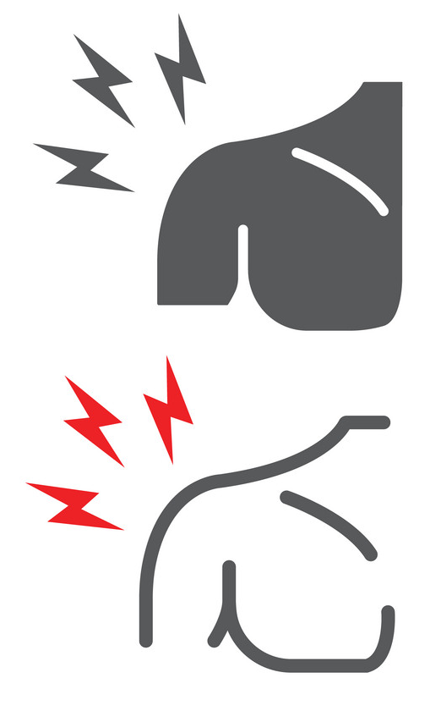
Range of Motion
The American College of Sports Medicine (ACSM) recommends performing bench press through its full range of motion.
Notes:
The American College of Sports Medicine recommends performing exercises through their full range of motion (ACSM 1995).
Kolber (2010) review of the literature found that the bench press has been implicated in shoulder injuries including osteolysis, soft tissue strains and tears, anterior instability, and dislocations. The lowering-eccentric phase of the bench press has been postulated to be responsible for many of the injuries particularly when the arm was lowered below the torso. (Kolber 2010, Morey 2010)
Haupt (2001) suggests the decent phase should finish 4-6 cm above the chest. Morey (2010) suggests limiting the end-range positioning on the bench press by placing a towel roll or barbell pad on the chest to possibly mitigate risk from the terminal lowering phase.
However, there is no actual evidence demonstrating that bench pressing through a full range of motion (as recommended by the ACSM) is inherently dangerous for most individuals. In fact, restricting range of motion may decrease flexibility, strength, and joint adaptations through the omitted range of motion, thereby potentially increasing risk of future injury.
Strength Training performed through a full range of motion has been shown to increase and maintain joint flexibility (Morton 2011, Souza 2013). Flexibility shoulder flexibility will likely decrease if shoulders do not travel through full range of motion (until slight stretch or pull is felt through shoulder or chest, while maintaining shoulder retraction) unless specific stretches or movements are performed to supplement program compromised by limited range of motion.
Exercising through a full range may be the only means of maintaining flexibility through the Pectoralis major and minor for most individuals engaging in weight training. However those with a thicker rib cage or those performing a powerlifting-style bench press will have less lower range of motion due to the arched back position. Tight Pectoralis muscles in addition to particular muscular imbalances may contribute to Protracted Shoulder Girdle posture which could potentially create or exacerbate the mechanical issues in which Haupt (2001) and Morey (2010) were attempting to circumvent. See Forces Through Shoulder Joint above.
Therefore, restricting range of motion during the bench press as described by Haupt (2001) and Morey (2010) should be prescribed only for those with specific shoulder injuries or dispositions. In which case shoulder flexibility movements for the Pectoralis major, Pectoralis minor, and Anterior Deltoid (second column under 'Stretch') will likely need to be a part of the rehabilitation program until fuller a range bench press movement can safely be performed. Also see suggested exercises for Protracted Shoulder Girdle.
Fees (1998) points out that the narrower 1.5 times biacromial width grip actually increases transverse flexion. This may be true in a flat back bench position, however the arched spine position typically performed by powerlifters can actually decrease range of motion since the bar does not need to be lowered as far with the low chest raised upward. Again this limited range of motion may require assistance work with dumbbells and/or wide grip benching to mitigate the effects of a limited range of motion (ie: protracted shoulder posture and its resulting biomechanical issues).

Slide 11
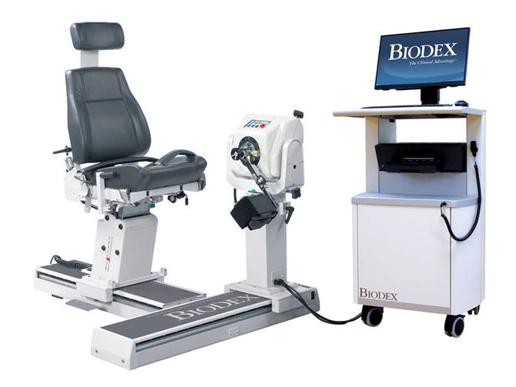
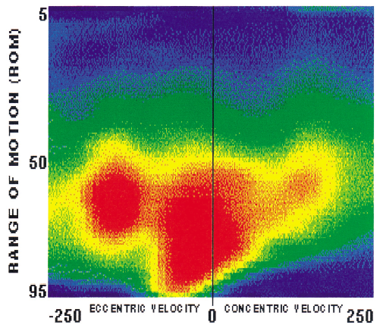
Isokinetic Evaluation
Notes:
مزیت ها: آخرین مدل دستگاه

Slide 12
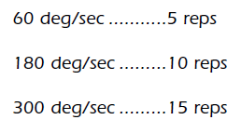
Isokinetic Measurement
Number of repetitions
Preset angular velocity
Type of muscle contraction
Pick the right movement
Warm-up and familiarization
Peak performance
Notes:
نوع انقباض، سرعت حرکت، فیکس بودن ورزشکار و حداکثر تلاش

Slide 13
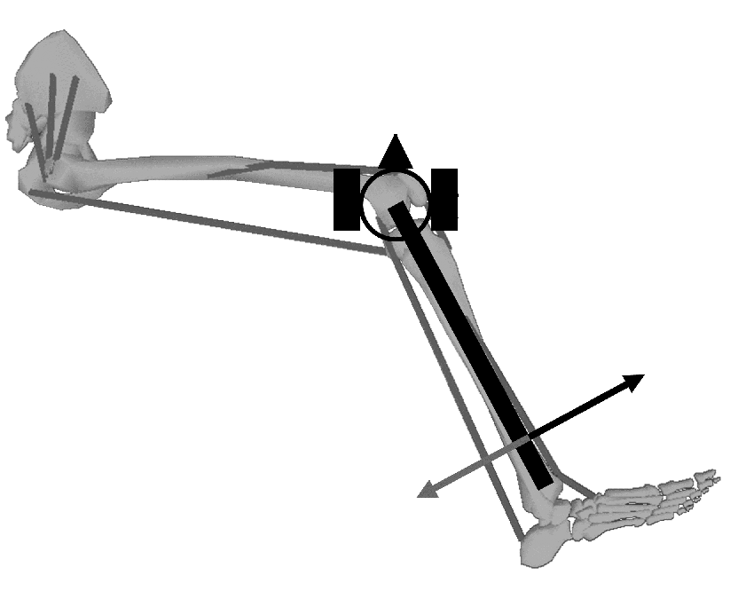
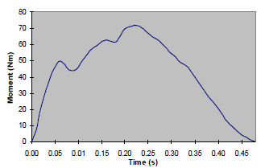
How it works?
Control Unit
Resistive Mechanism
Angular Velocity sensor
Sampling frequency: 100 Hz
Notes:
نوع انقباض، سرعت حرکت، فیکس بودن ورزشکار و حداکثر تلاش

Slide 14
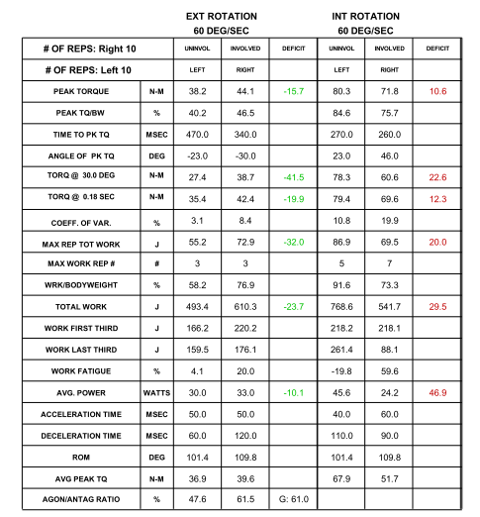
نتایج آیزوکینتیک

Slide 15
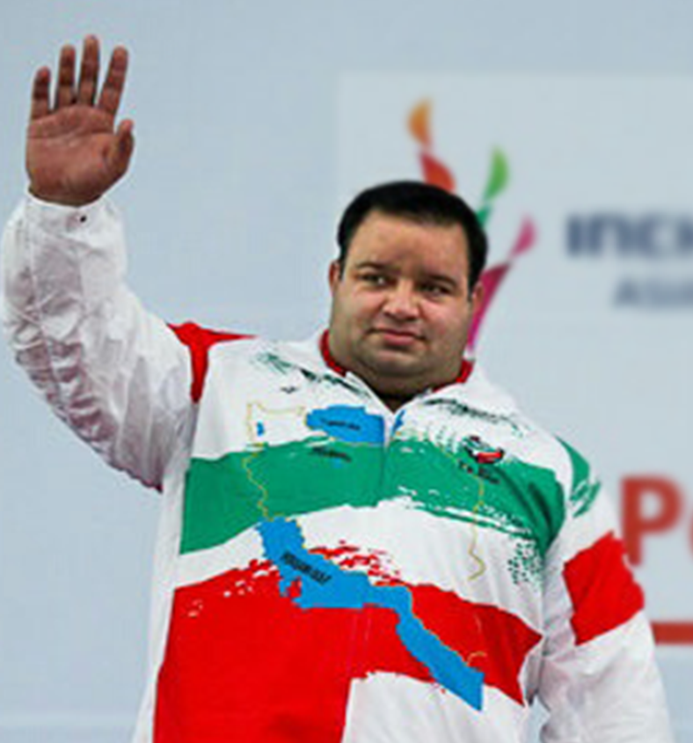
Mansour Pourmirzaei (Powerlifting)
Internal to External Rotation Strength Ratio
31
27
6
5
26
24
Notes:
در مورد هر دوی مفاصل زانوی پای راست و چپ
Weight 99.7 102.4
SMM 45.5 46.7
BMI 30.6
Percent Body Fat 20.2 20.4
The external rotators had a high activity level during baseball pitching, especially during deceleration of the pitching arm in the follow-through phase. Alderink and Kuck (1986) suggested that perhaps training programs should strive to increase the ER:IR ratio²¹⁾. Increasing the concentric ER:IR ratio to 76% has been suggested¹⁰⁾. Increasing the external rotation could effectively bias this ratio and add greater stability to the shoulder joint in athletes performing overhead activities and possibly prevent shoulder injuries.
بر اساس نتایج ارزیابی ضعف قدرت عضلات همسترینگ نسبت به عضلات چهار سر در این ورزشکار در مورد هر دوی مفاصل زانوی پای راست و چپ مشهود است که این ضعف با در نظر گرفتن فاکتورهای PEAK TORQUE و همینطور ACCELERATION TIME و DECELERATION TIME کاملا مشهود است، که این ضعف علاوه بر مستعد کردن ورزشکار در بروز آسیب دیدگی باعث ضعف عملکردی خواهد شد، بنابراین تقویت این عضلات از طریق تمرینات قدرتی و فانکشنال توصیه می شود.
همیچنین نتایج ارزیابی آیزوکینتیک مفاصل شانه چپ و راست نشان می دهد ورزشکار در تغییر حالت انقباض مفصل برای مثال از ابداکشن به اداکشن یا فلکشن به اکستنشن و بالعکس با سرعت بالا دچار ضعف است که این عامل می تواند ورزشکار را از نظر عملکردی دچار مشکل کند، بنابراین تمرینات عملکردی شامل تغییر مداوم حالت انقباض و فعالیت مفصلی برای این ورزشکار توصیه می شود.
ارزیابی دوم: در این مرتبه ارزیابی مفصل زانو AGON/ANTAG RATIO مقادیر 60 درصد برای پای راست و چپ ثبت شده است. خستگی برای عضلات فلکسور در سرعت پایین و تکرار بالا حدود 35.7 درصد و برای اکستنسور نزدیک 20 درصد مشاده شده است.
در این مرتبه اندازه گیری قدرت اکسترنال روتیشن شانه نصف اینترنال روتیشن مشاهده شده است، که نسبت به مرحله قبل کاهش شدیدی نشان می دهد و در مرحله قبل نسب قدرت مطلوبی مشاهده شد.
برای مفصل ران خستگی برای حرکت اکستنشن نزدیک 60 درصد و برای فلکشن تنها 10 درصد بود! تفاوت حداکثر قدرت در حرکت سرعت بالا برای فلکشن به اکستنشن تا 5 برابر نیز می رسد که نشاندهنده قدرت بسیار کمتر عضلات اکستنسور به فلکشور است.

Slide 16
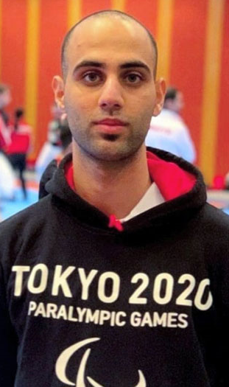
Mehdi Poor Rahnama
(Para Taekwondo)
Hamstring to Quadriceps Strength Ratio
Notes:
وزن ۷۰ کیلو در مقایسه با سنجش قبلی 2/5کیلو کاهش وزن داشتند
با توجه به وزن مسابقه ای منهای ۷۵ نیاز به برنامه غذایی برای افزایش تدریجی وزن دارند
BMI محاسبه شده 21/78
درصد چربی بدن 12/5

Slide 17
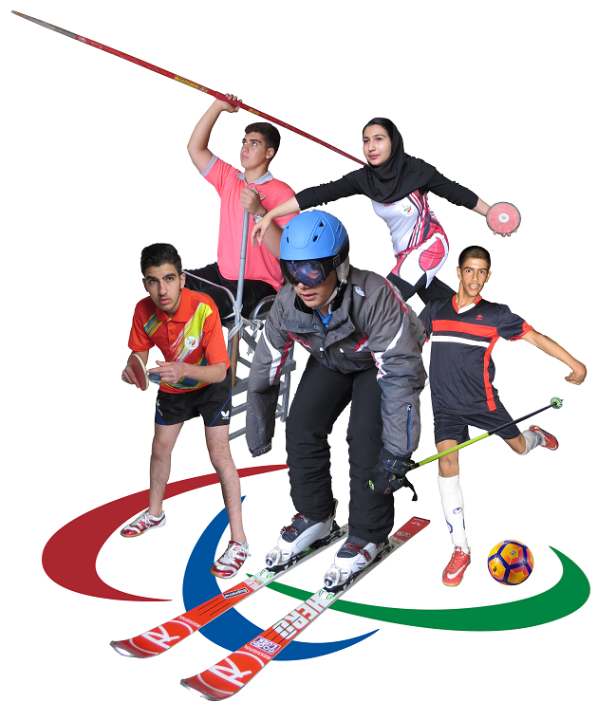
THANK YOU
FOR YOUR
ATTENTION

